Slide 1
Design Patterns and Refactoring
Book: Improving the Design of Existing Code by Martin Fowler
Lecture - 1

Slide 2

Refactoring
Performance Optimization?

Slide 3
Refactoring Cont.
A change made to the internal structure of software to make it easier to understand and cheaper to modify without changing its observable behavior.
Purpose is to make the software easier to understand and modify
–Changes done for performance optimization are not refactoring

Slide 4
Refactoring Cont.
Why to refactor?
When to refactor?
When You Add Functionality
When You Need to Fix a Bug
When You Do a Code Review
When Not to refactor?
when you are close to a deadline
Messy code, it would be easier to start from the begining.
Code has to work mostly correctly before you refactor

Slide 5

Are You A Good programmer?
Why???
What are the parameters for defining a good programmer?
BAD SMELLS

Slide 6
Code Smells
Duplicated Code
Same expression in two methods of the same class
Same expression in two sibling subclasses
Methods do the same thing with a different algorithm
Duplicated code in two unrelated classes
Refactoring
Extract method
Extract method & Pull up field
Substitute algorithm
Extract class

Slide 7
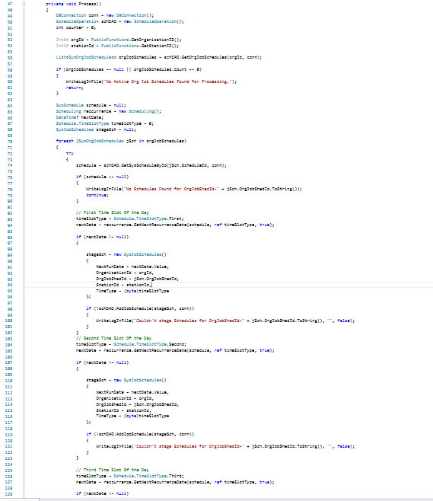
Long Method
Fucntion ProcessRequest()
GetAllAlerts()
.......
foreach on alerts
.......
Prepare mail body
Send email
Add to history
.......
Delete this entry from database
Consits of 111 lines

Slide 8
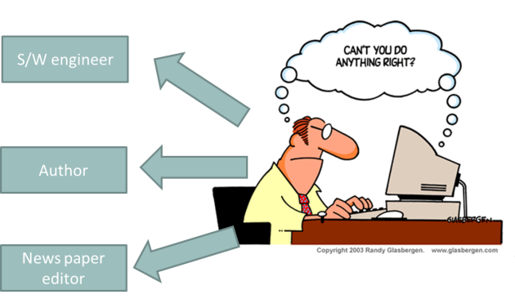
Long Method Cont.
SINGLE RESPONSIBLITY PRINCIPLE

Slide 9

Long Method Cont.
Extract Method
Fucntion ProcessRequest()
{
List = GetAllAlerts();
SendEmail(List);
AddHistory(List);
DeleteAlert();
}
SRP

Slide 10
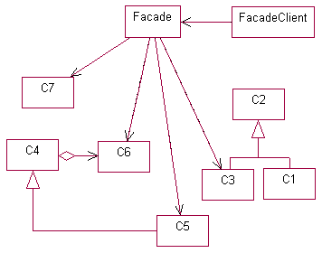
Facade
A simplified interface over sub system

Slide 11
Large Class
A class is trying to do too much
Too many instance variables, duplicated code
–Extract class
–Extract subclass

Slide 12
Long Parameter List
Introduce Parameter Object
Preserve Whole Object
int low = daysTempRange().getLow();
int high = daysTempRange().getHigh();
withinPlan = plan.withinRange(low, high);
withinPlan = plan.withinRange(daysTempRange());

Slide 13
Long Parameter List Cont.
Replace parameter with Method
int basePrice = _quantity * _itemPrice;
discountLevel = getDiscountLevel();
double finalPrice = discountedPrice (basePrice, discountLevel);
int basePrice = _quantity * _itemPrice;
double finalPrice = discountedPrice (basePrice);

Slide 14
Refactorings
Extract Method
Inline Method
Inline Temp
Replace Temp with Query
Introduce Explaining Variable
Split Temporary Variable
Substitute Algorithm

Slide 15
Inline Method
A method's body is just as clear as its name
Put the method's body into the body of its callers and remove the method

Slide 16
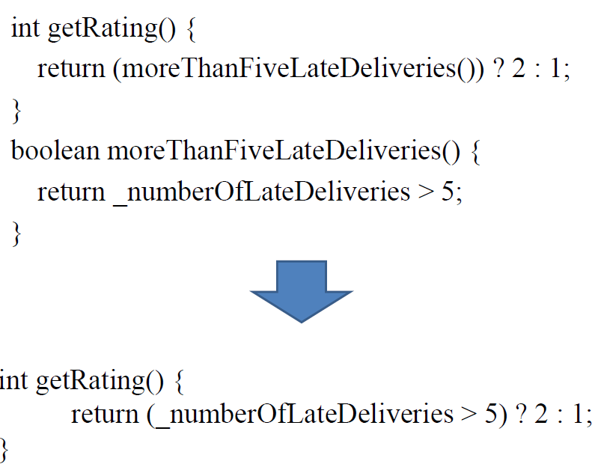
Inline Method Cont.

Slide 17
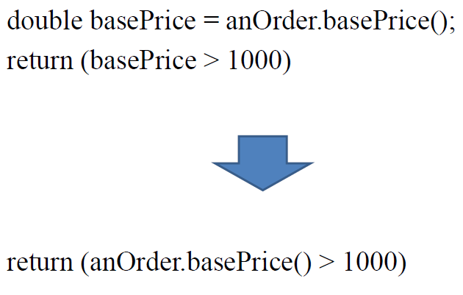
Inline Temp

Slide 18
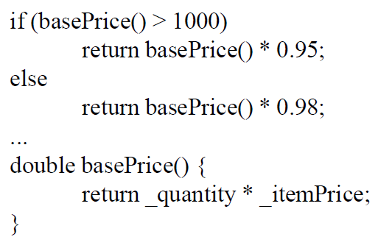
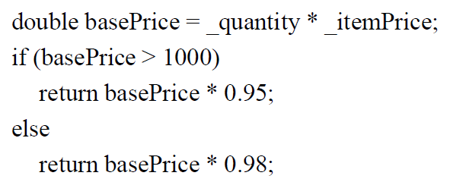
Replace Temp With Query
You are using a temporary variable to hold the result of an expression

Slide 19

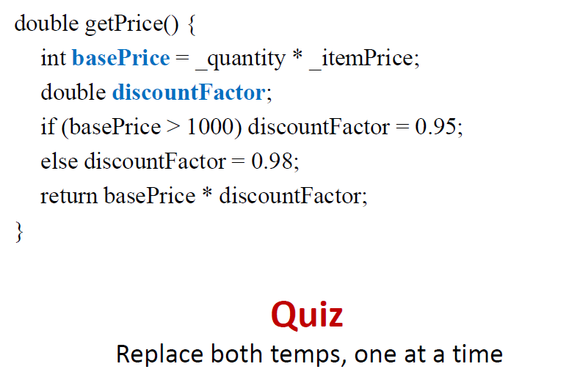

Slide 20
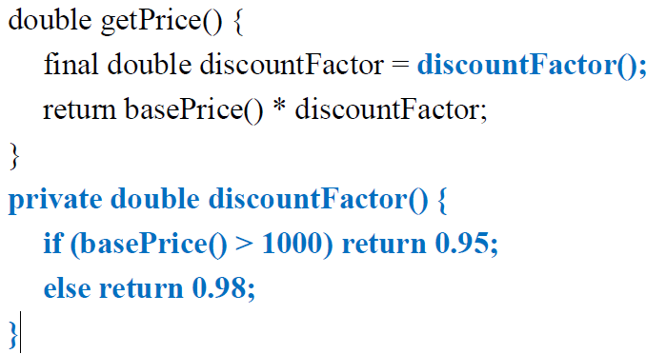
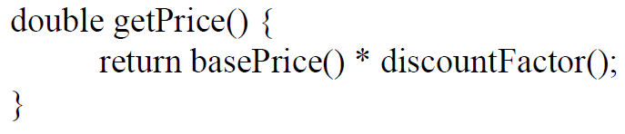
Quiz Solution

Slide 21
Introduce Explaining Variables
You have a complicated expression
Put the result of the expression, or parts of the expression, in a temporary variable with a name that explains the purpose

Slide 22
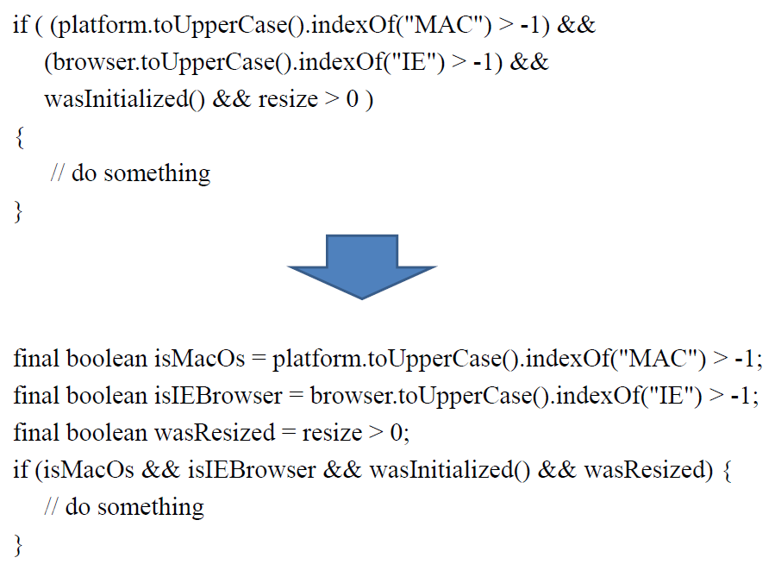
Introduce Explaining Variables Cont.

Slide 23
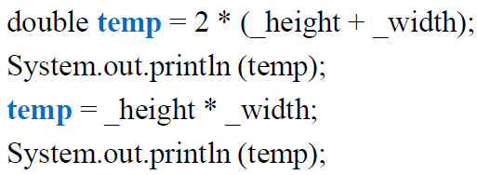
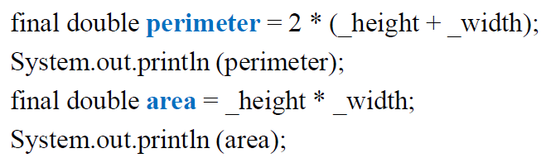
Split Temporary Variable
You have a temporary variable assigned to more than once, but is not a loop variable nor a collecting temporary variable
Make a separate temporary variable for each assignment 68

Slide 24

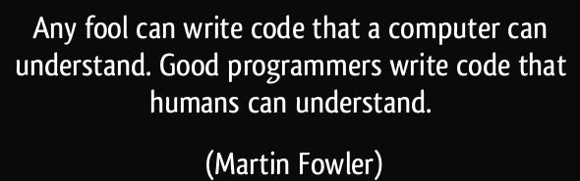
Refactor small change
Test
Refactor small change
Test
Refactor small change
Test
Refactor small change
Test

